Slide 1
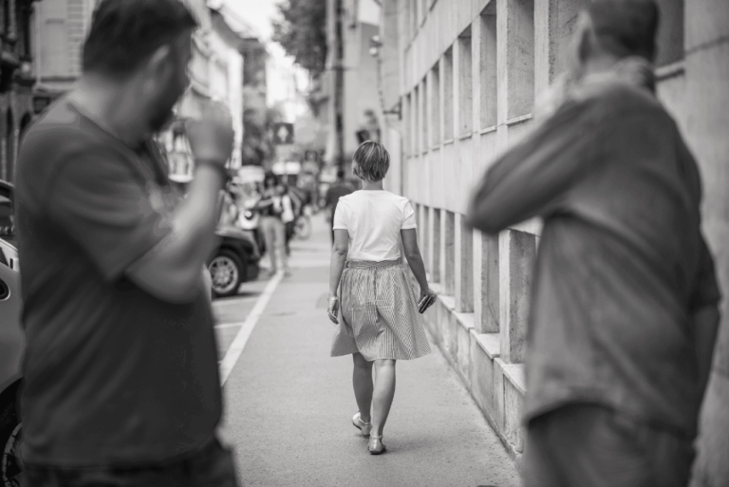

ROUTE OPTIMIZATION FOR PREVENTION OF STREET HARRASSMENT IN MEDELLIN

Slide 2

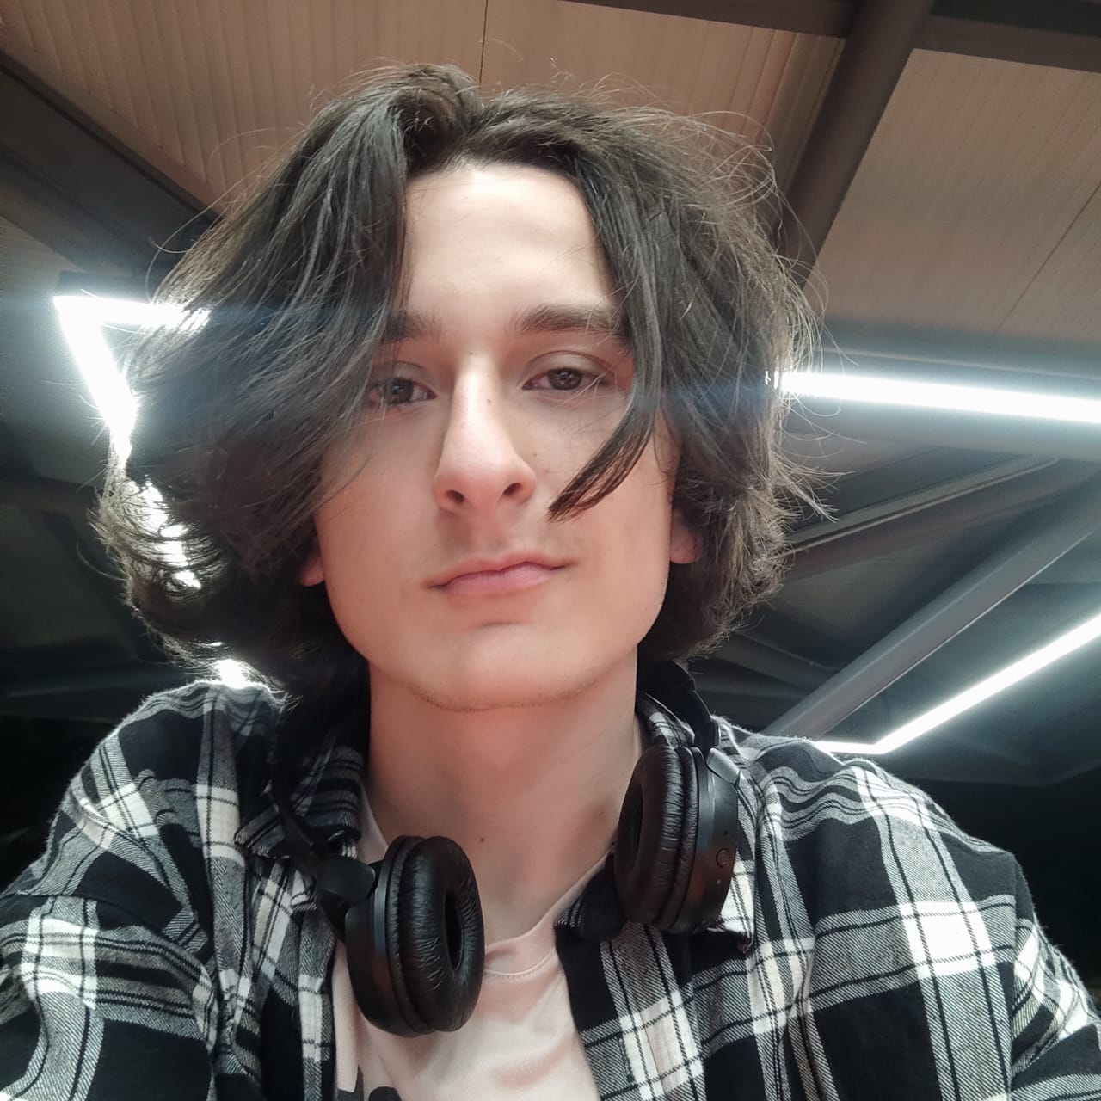
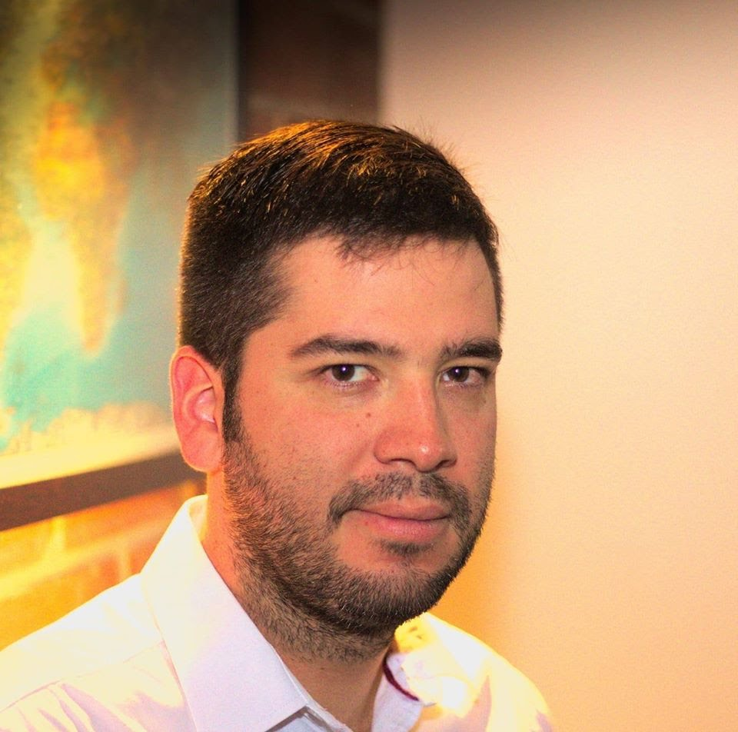
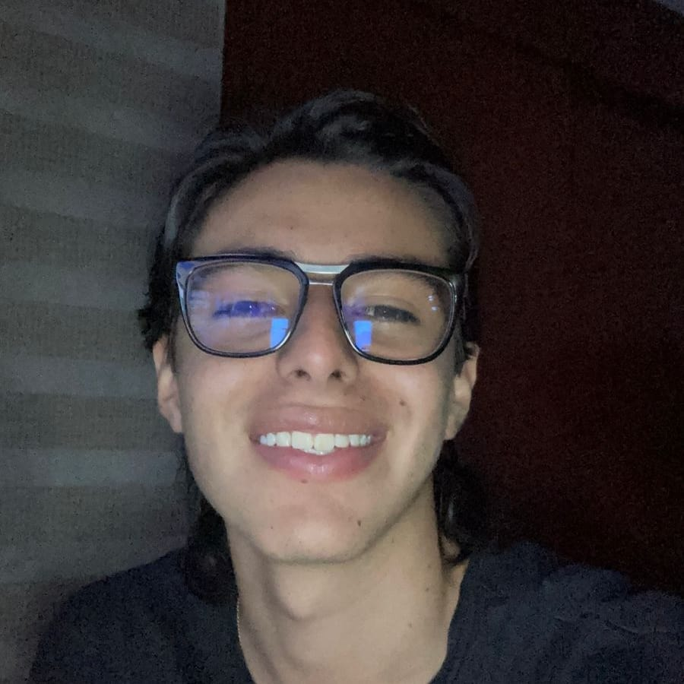
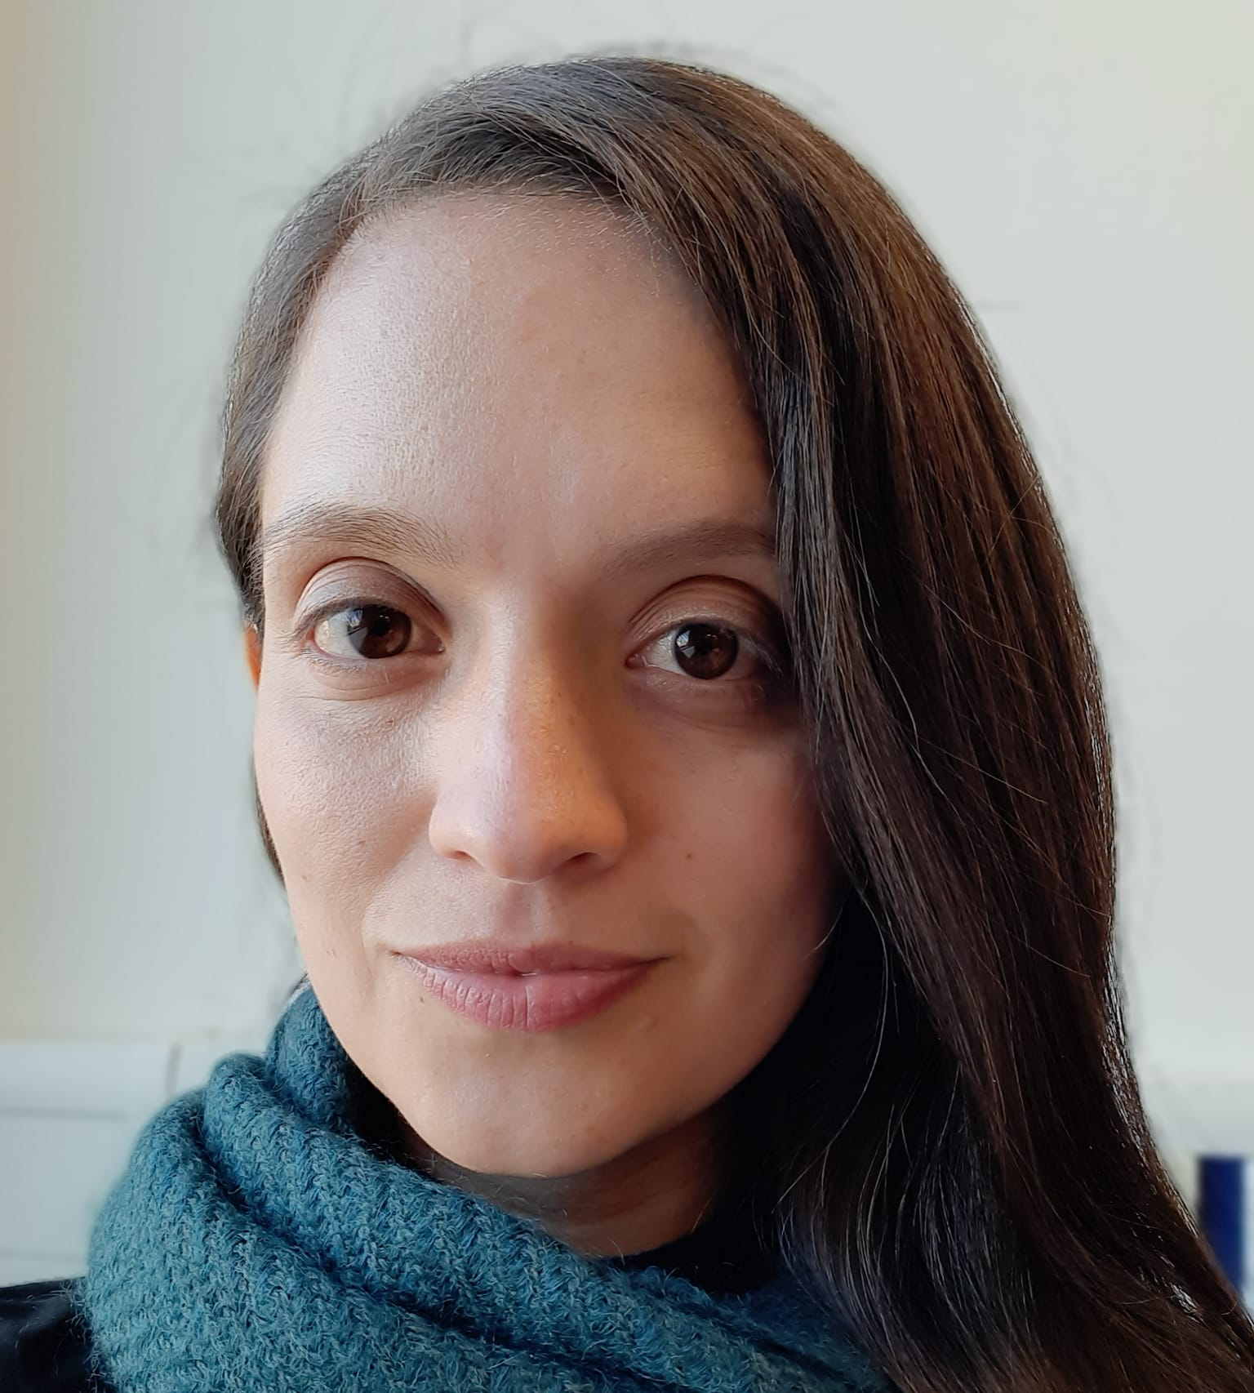

Our wonderful team!
Thomas Martinod
Leader
Emanuel Serna
Programmer
Andrea Serna
Literature reviewer
Mauricio Toro
Consultant
https://github.com/ThomasMartinod/SafeMED/

